Slide 1
DATA ANALYSIS TRAINING

Slide 2
Data is details of a particular place to collect.
Analysis is studying or examine something to understand more details.
Data Analysis is the process of examine data with some tools to get insight.
Data analysis is the process of inspecting, cleaning, transforming, and modeling data to discover useful insights, inform conclusions, and support decision-making. It is widely used in business, science, social research, and almost every industry today.
Data Analytics can be described as the process of collecting data, using data to answer questions, identify trends, and extract insights.
01
INTRODUCTION

Slide 3
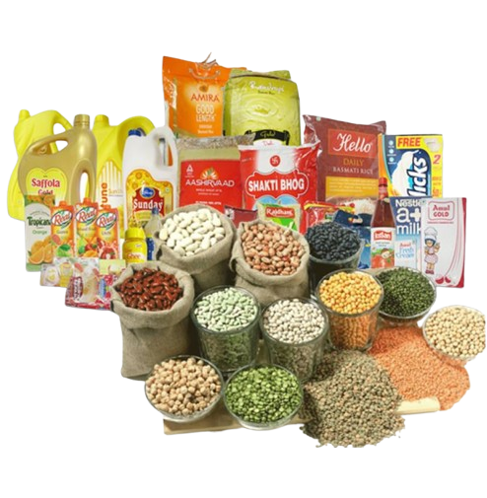

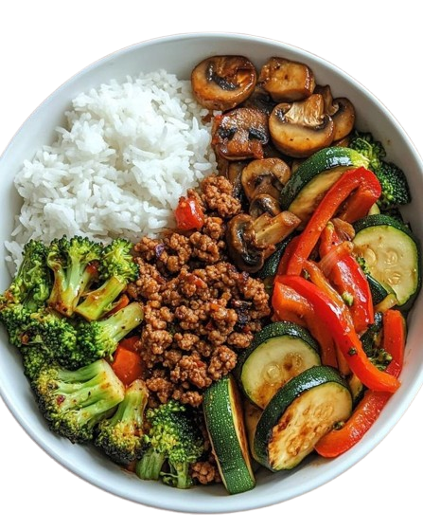

GROCERIES
COOKING
The Meal
01
RAW DATA
DATA ANALYSIS
The Insight
WHAT YOU DO AFTER EATING
INTRODUCTION
DECISION

Slide 4
Make better decisions
Reduce guesswork
01
Improve efficiency
Understand customers
WHY ORGANIZATIONS RELY ON DATA
Increase profit or impact
N.B: Without data, Decisions are opinions

Slide 5
Can you name one decision in your daily life that could be improved with data?

Slide 6
Types of Analytics
Descriptive Analytics: Focuses on what happened.
Predictive Analytics: What might happen in the future.
Prescriptive Analytics: What should be done next.
Diagnostic Analytics: Why did this happen.
01
Analytical Thinking: involves identifying and defining a problem and then solving it by using data in an organized, step by step approach.
5 KEY ASPECTS TO ANALYTICAL THINKING
Visualization: Graphical representation of information
Strategy: helps see what they want to achieve.
Problem-orientation: Discovering and discussing the problem.
Correlation: Relationship in a data.
Big-picture & Detail-oriented thinking.
INTRODUCTION CONT’D

Slide 7
Match each analytics type to these scenarios:
Monthly sales report
Customer churn investigation
Demand forecast
Pricing recommendation
N.B: You don’t need to use google or AI; just apply your normal knowledge
ASSIGNMENT

Slide 8

LIFECYCLE OF DATA
Planning: When a business decides what kind of data it needs, how it will be merged, who will be responsible, & outcomes.
Capture data: where data is collected from a variety of different sources and brought into the organization.
Manage: how we care about our data, how & where it is stored.
Analyze: involves using data to solve problems, make great decisions, and supply business goals.
Archive: Keep relevant data stored for long term & future reference.
Destroy: remove data from storage and delete any stored copies of the data.

Slide 9
01
ASK: We define the problem to be solved and we make sure that we fully understand.
02
PREPARE: Where data is collected and stored for the upcoming analysis.
PHASE OF DATA ANALYSIS
03
PROCESS: Where data analysis find and eliminate any errors that can affect the way of result.
04
ANALYZE: involves using tools to transform data to derive useful conclusions, make predictions & derived decision making.

Slide 10
05
SHARE: Where data analyst interpret result and share them with others to help stakeholders make effective data driven decisions.
N.B: Visualization is the best friend in this phase.
06
ACT: Where all the insights are put to work.
PHASE OF DATA ANALYSIS
ASK
PREPARE
PROCESS
ANALYZE
SHARE
ACT

Slide 11

SCENARIOS
Scenario: A Local Café Wants to Improve Sales
Imagine you own a small café in Lagos. Lately, you've noticed that some days are busier than others, but you don't know why. You decide to collect data to figure out what’s happening.
Step 1: Gathering Data
You track sales for different days of the week and write down the number of customers, popular menu items, and average spending per customer:
DAY | CUSTOMERS | POPULAR ITEMS | AVG SPENDING
MON | 30 | Cappuccino | $4.50
TUE | 25 | Croissant | $3.80
WED | 40 | Mocha Latte | $5.20
THUR | 20 | Espresso | $3.00
FRI | 60 | Cheesecake | $6.50
SAT | 80 | Iced coffee | $5.80
SUN | 70 | Pan cake | $6.00

Slide 12
Step 2: Analyzing the Data
Now, let's ask some important questions to analyze the numbers:
Which day has the most customers? →
Which item sells the most on busy days? →
On which days do fewer people visit? →
What’s the highest-spending day? →
Step 3: Finding Insights and Making Decisions
Based on this analysis, you might take action to improve business:
Offer discounts on slow days like Thursday to attract more customers.
Promote cheesecake and iced coffee with special deals on busy days.
Open a loyalty program for high spenders on Fridays.
The Power of Data Analysis
Instead of guessing, you now use data to make smarter decisions that can increase sales and customer satisfaction. This is exactly how companies, governments, and individuals use data in real life!

Slide 13
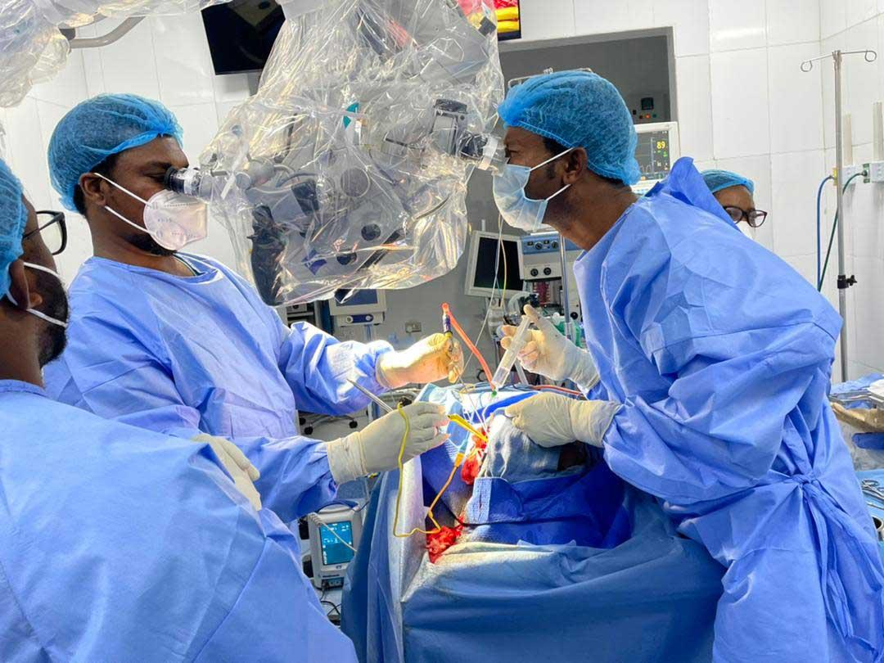
ASSIGNMENTS
Let's explore a health-related scenario to show how data analysis can be used in healthcare.
Scenario: A Hospital Wants to Reduce Patient Wait Time
Imagine you work as a data analyst at a hospital. Patients have been complaining about long wait times to see a doctor. The hospital decides to collect data to find out what’s causing the delay.
Step 1: Gathering Data
The hospital tracks wait times for different departments over one week:
DEPARTMENT | AVG WAIT TIME (MINS) | NO OF PATIENTS/DAY
General Checkup | 45 | 100
Pediatrics | 30 | 80
Cardiology | 60 | 50
Emergency Room | 20 | 150
Neurology | 55 | 40

Slide 14
Step 2: QUESTIONS
Which department has the longest wait time? →
Which department has the shortest wait time? →
Is there a link between patient numbers and wait time? →
Which department is busiest? →
Find the Insights and Make Decisions

Slide 15
A Data Analyst is someone who Uses data to answer business questions and communicate insights clearly to decision-makers.
WHO IS A DATA ANALYST?

Slide 16
ASSIGNMENT
READ ON
DATA WRANGLING
DATA MODELING
DATA VISUALIZATION
DATA CLEANING
DATA MINING
DATA EXPLORATION
SEE YOU IN THE NEXT CLASS

